Slide 1
Machine Learning Foundations and Applications
Jiaul Paik

Slide 2
Topics
Backpropagation

Slide 3









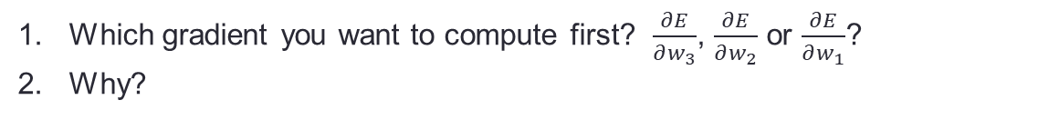







































Recap
$$b_{1}$$
$$b_{2}$$
$$b_{3}$$
$$w_{1}$$
$$w_{2}$$
$$w_{3}$$
x
1
2
3
$O_{3}$ (output)
$$I_{1}=w_{1}∗x+b_{1}$$
$$I_{2}=w_{2}∗{ f(I}_{1})+b_{2}$$
$$I_{3}=w_{3}∗f(I_{2})+b_{3}$$
$$O_{1}=f(I_{1})$$
$$O_{2}=f(I_{2})$$
$$O_{3}=f(I_{3})$$
Error/performance function: $E=\frac{1}{2}{\left(O_{3}−y\right)}^{2}$
gradients: the common parts
$\frac{∂E}{∂w_{3}}$ =
$\frac{∂E}{∂O_{3}}$
$\frac{∂O_{3}}{∂I_{3}}$
$\frac{∂I_{3}}{∂w_{3}}$
$\frac{∂E}{∂w_{2}}$ =
$\frac{∂E}{∂O_{3}}$
$\frac{∂O_{3}}{∂I_{3}}$
$\frac{∂I_{3}}{∂O_{2}}$
$\frac{∂O_{2}}{∂I_{2}}$
$\frac{∂I_{2}}{∂w_{2}}$
$$×$$
$$×$$
$$×$$
$$×$$
$$×$$
$$×$$
$\frac{∂E}{∂w_{2}}$ =
$\frac{∂E}{∂O_{3}}$
$\frac{∂O_{3}}{∂I_{3}}$
$\frac{∂I_{3}}{∂O_{2}}$
$\frac{∂O_{2}}{∂I_{2}}$
$\frac{∂I_{2}}{∂w_{2}}$
$\frac{∂E}{∂w_{1}}$ =
$\frac{∂E}{∂O_{3}}$
$\frac{∂O_{3}}{∂I_{3}}$
$\frac{∂I_{3}}{∂O_{2}}$
$\frac{∂O_{2}}{∂I_{2}}$
$\frac{∂I_{2}}{∂O_{1}}$
$\frac{∂O_{1}}{∂I_{1}}$
$\frac{∂I_{1}}{∂w_{1}}$
$$×$$
$$×$$
$$×$$
$$×$$
$$×$$
$$×$$
$$×$$
$$×$$
$$×$$
$$×$$
Which gradient you want to compute first? $\frac{∂E}{∂w_{3}}$, $\frac{∂E}{∂w_{2}}$ or $\frac{∂E}{∂w_{1}}$?
Why?

Slide 4
Backpropagation on Bigger Network

Slide 5


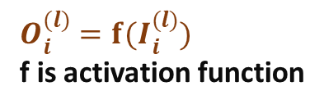

Layer no ---->
1
2
3
4
5
6
$$x_{1}$$
1
1
1
1
1
Z (output)
$$x_{2}$$
2
2
2
2
2
$$O_{i}^{(l)}=f(I_{i}^{(l)})$$
f is activation function
$I_{i}^{(l)} →$input to i-th neuron of l-th layer
$$O_{i}^{(l)}→output from \text{i}\text{−}\text{th} \text{neuron} \text{of} \text{l}\text{−}\text{th} \text{layer}$$

Slide 6
